Slide 1
Online Retail Data Analysis

Slide 2
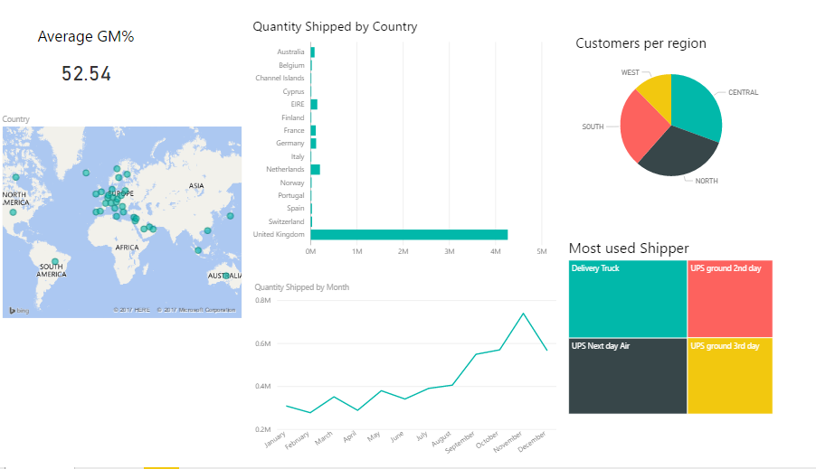
Highest GM% is from West: 52.62%

Slide 3
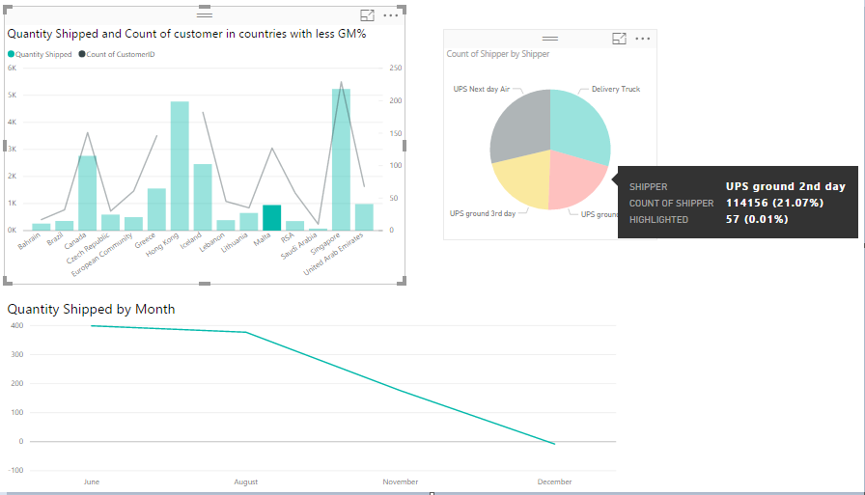
Since in most countries with low GM%, the customers have started using online retail recently, we need to focus more on shipper.

